Slide 1
Hospital management system
Presented by
Zarin Tasnim Mim(18502003563)
Sumaiya Aktar(18502003558)

Slide 2
contents
Introduction
Objective of Project
Task of Project
Process of Project
Entity Relationship Diagram
Use Case Diagram
Data Flow Diagram
Screenshots
Conclusion

Slide 3
Introduction
Hospital management system is a computer system that helps manage the information related to health care and aids in the job completion of health care
It is a well-organized software solution for a hospital.
It performs all task systematically.
Is provides improved and optimized service.

Slide 4
Objective of project
To provide a user friendly environment where user can be serviced better.
To make functioning of service faster.
To eliminate the paper work for service in hospital.
To avoid problem such as record file missing.

Slide 5
Task of project
Patients can request for appointment for any doctor .
System will retrieve the details of the existing patients.
Assistant will help the new patients to update their details in the system.
Assistant can confirm or cancel the appointment.
Assistant will also inform the patient by telling the availability of doctors.

Slide 6
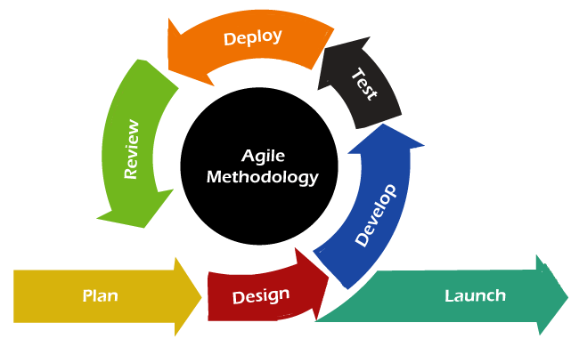
Process of project
The agile SDLC model illustrates the software development process based on iterative and incremental development. It breaks the task into smaller iterations & ensures customer satisfaction in every iteration.

Slide 7
Entity relationship diagram(erd)
ERD for hospital management system
Doctor’s availability check
doctor_-id
Doctor-name
has
Qualification
assistant
Doctor
Assistant_id
appointment
treatment
patient
Address
P_name
P_id
record

Slide 8
Use case diagram
Given below
Log in
Make appoinment
Cancel appoinment
Edit doctor details
doctor
assistant
Confrim appoinment
payment
prescription
patient

Slide 9
Data flow diagram
Level 0
Patient
Hospital system
Assistant
Doctor(s)

Slide 10
Data flow diagram
Level-1
External patient
Appointment request
Hospital system
Existing Patient details
New patient details
Appointment confirmation
Appointment cancelation
Doctor’s availability
Doctor’s free slot
Assistant’s action

Slide 11

screenshots
Home page

Slide 12
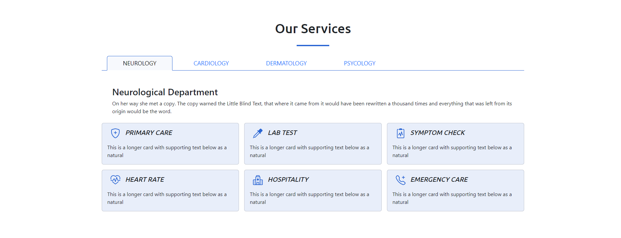
screenshots
service

Slide 13
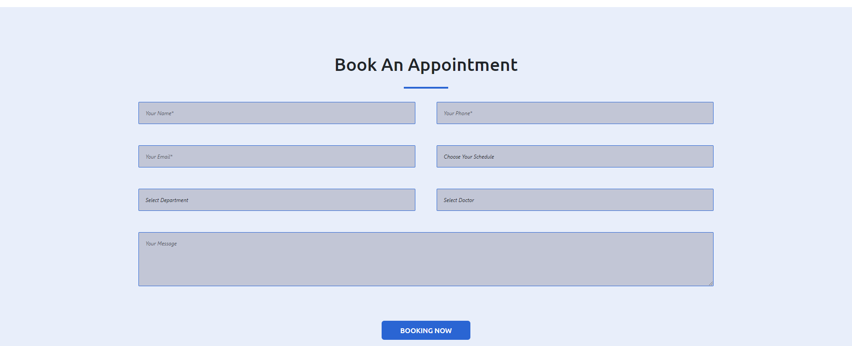
screenshots
Book an
appointment

Slide 14

screenshots
Our doctors

Slide 15

screenshots
Recent blogs

Slide 16
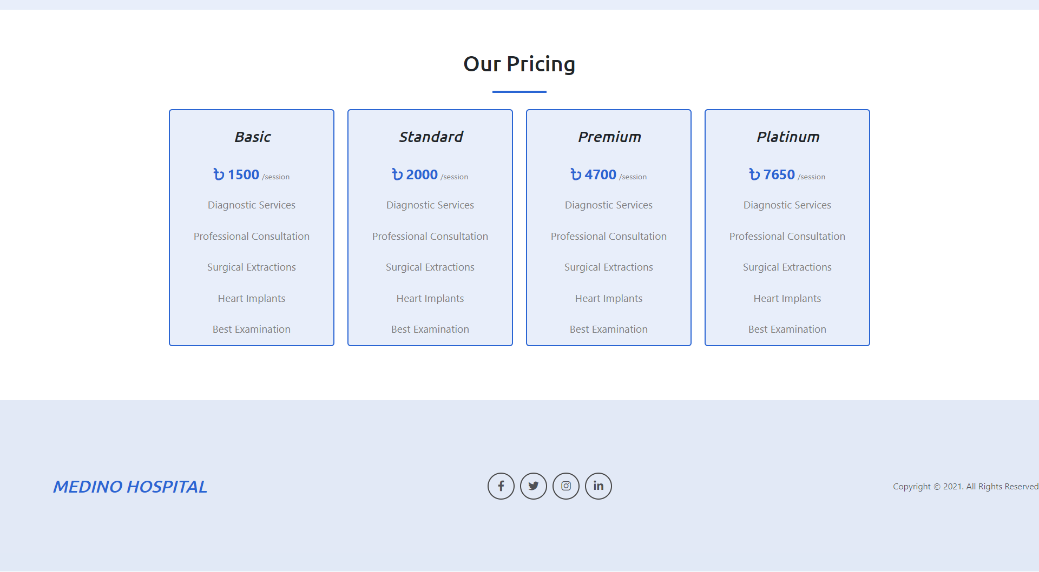
screenshots
Our pricing

Slide 17
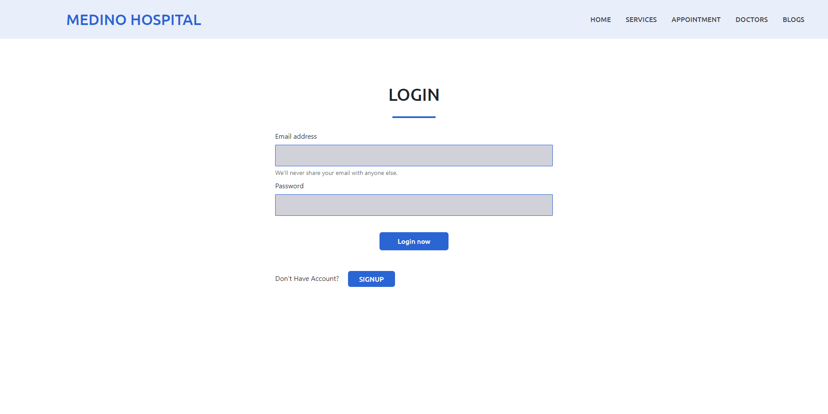
screenshots

Slide 18
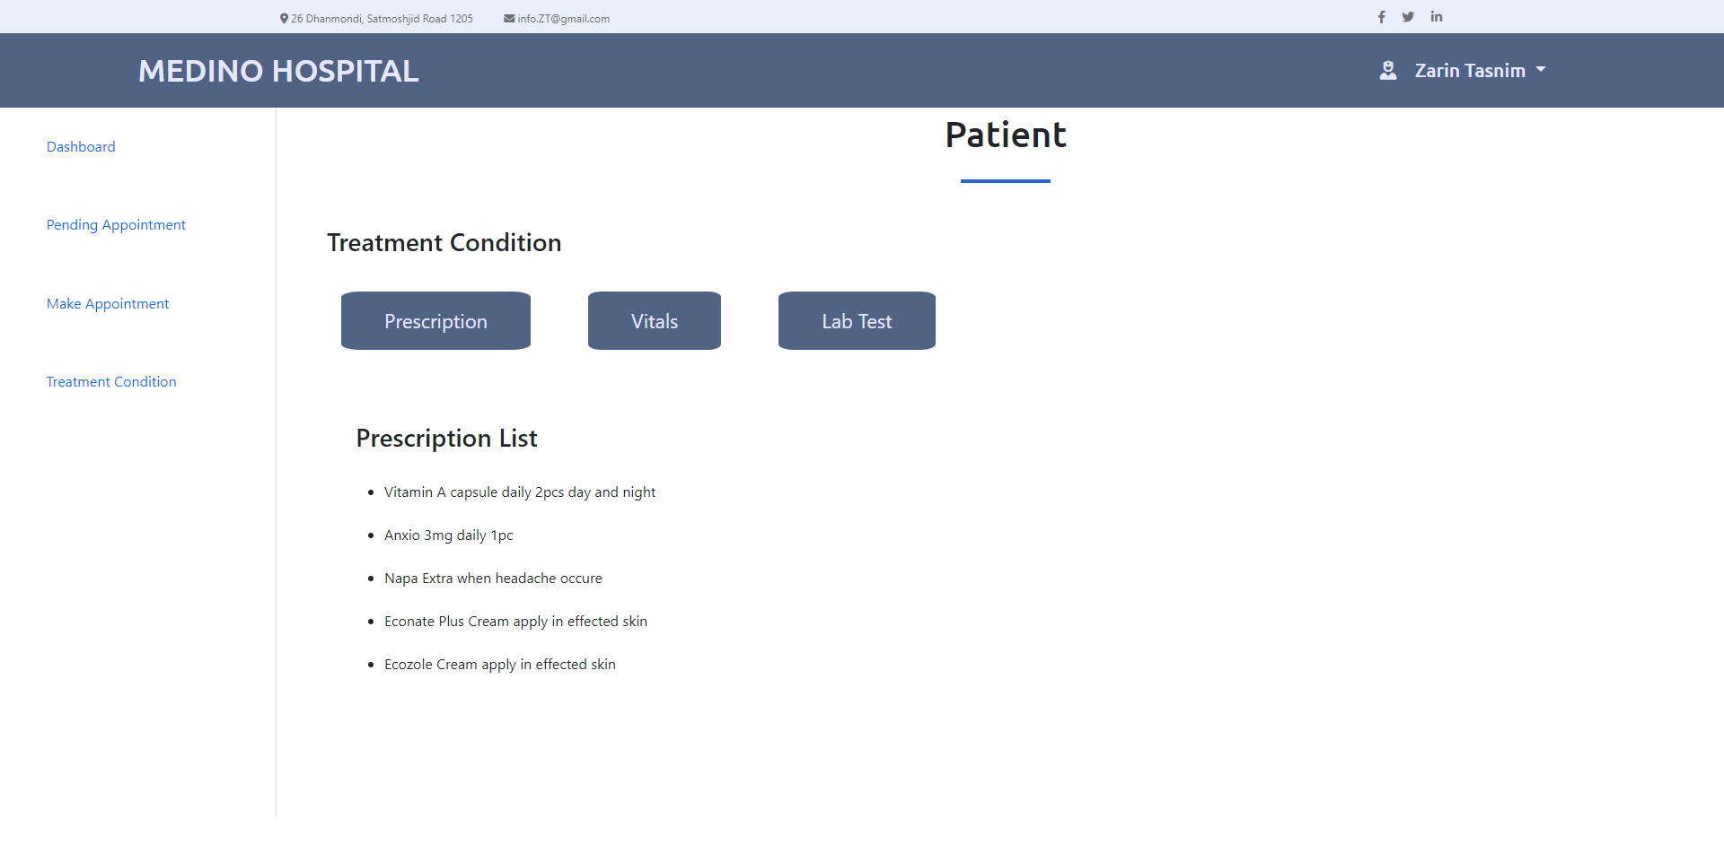
screenshots

Slide 19
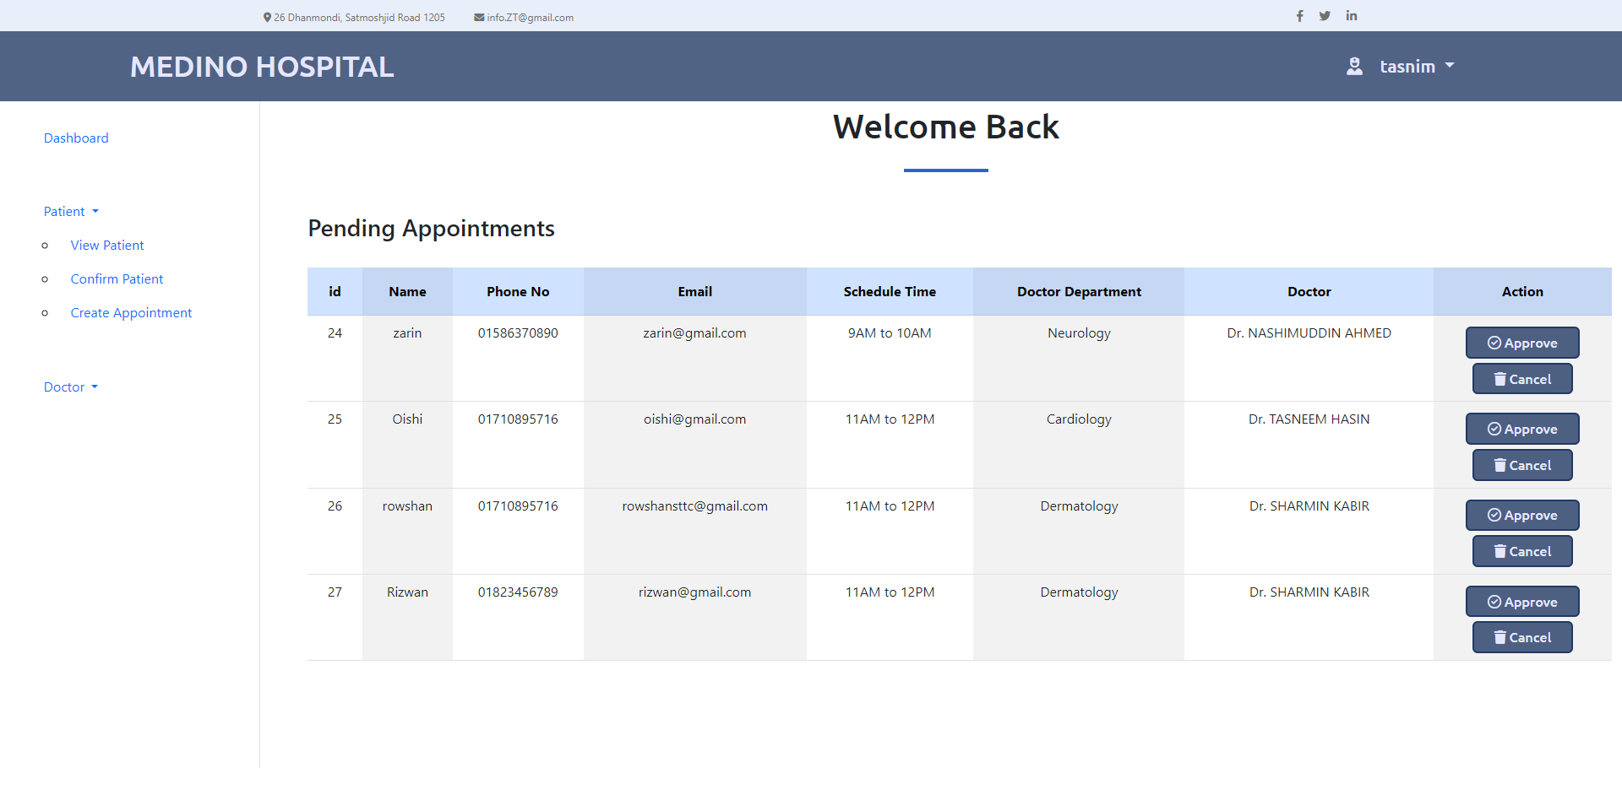
screenshots

Slide 20
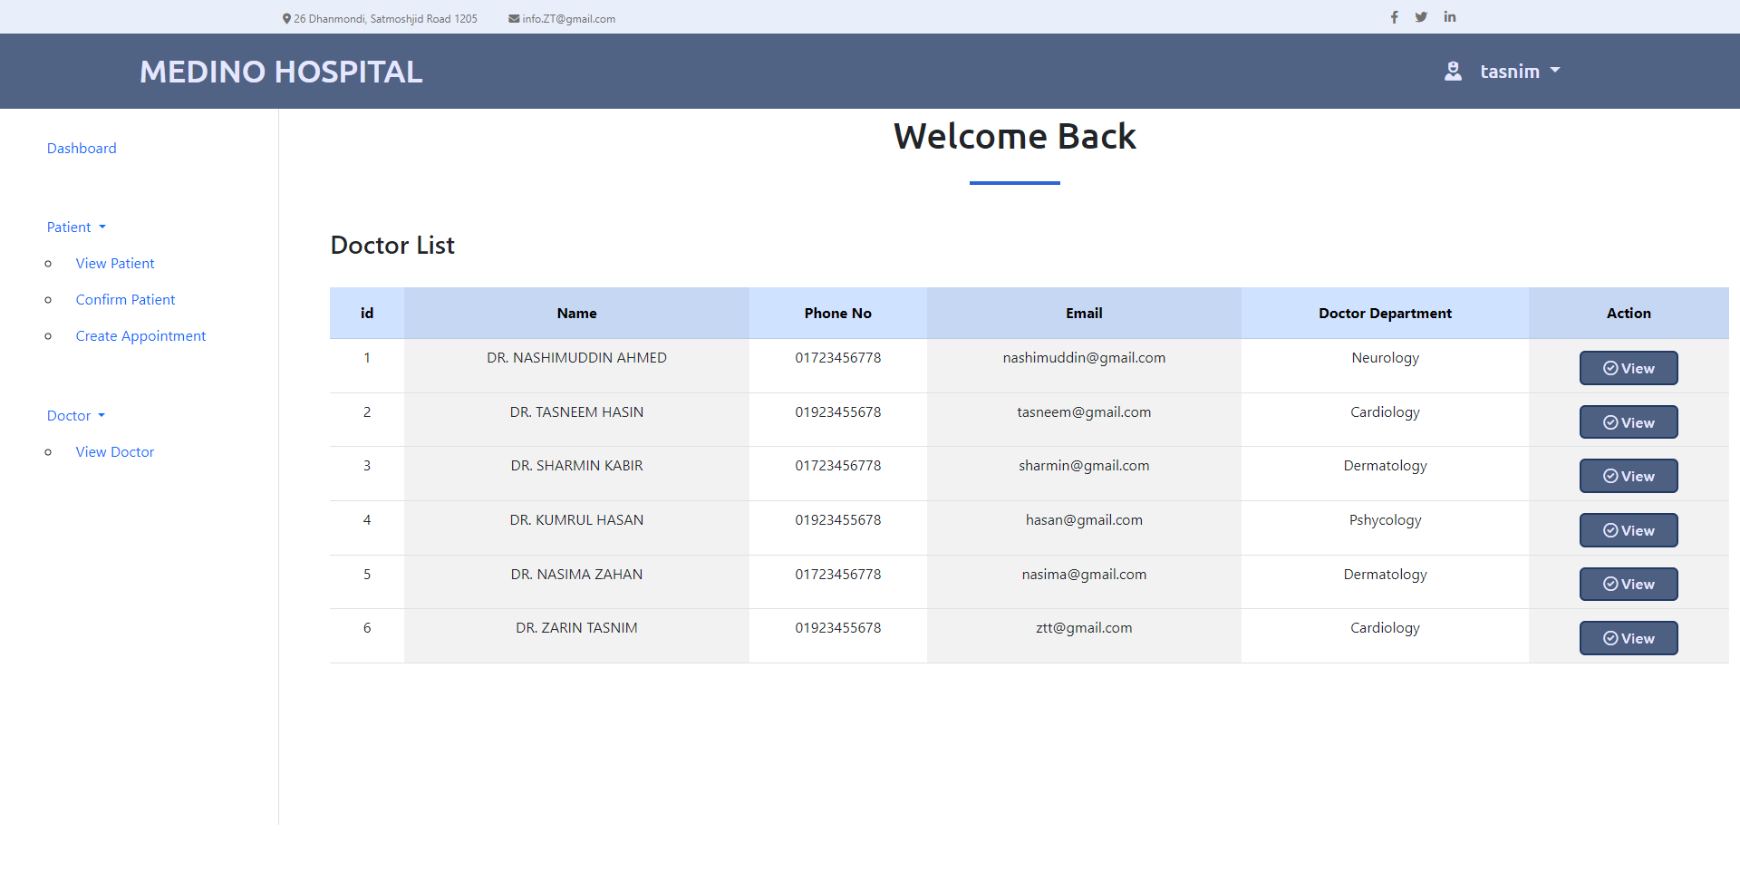
screenshots

Slide 21
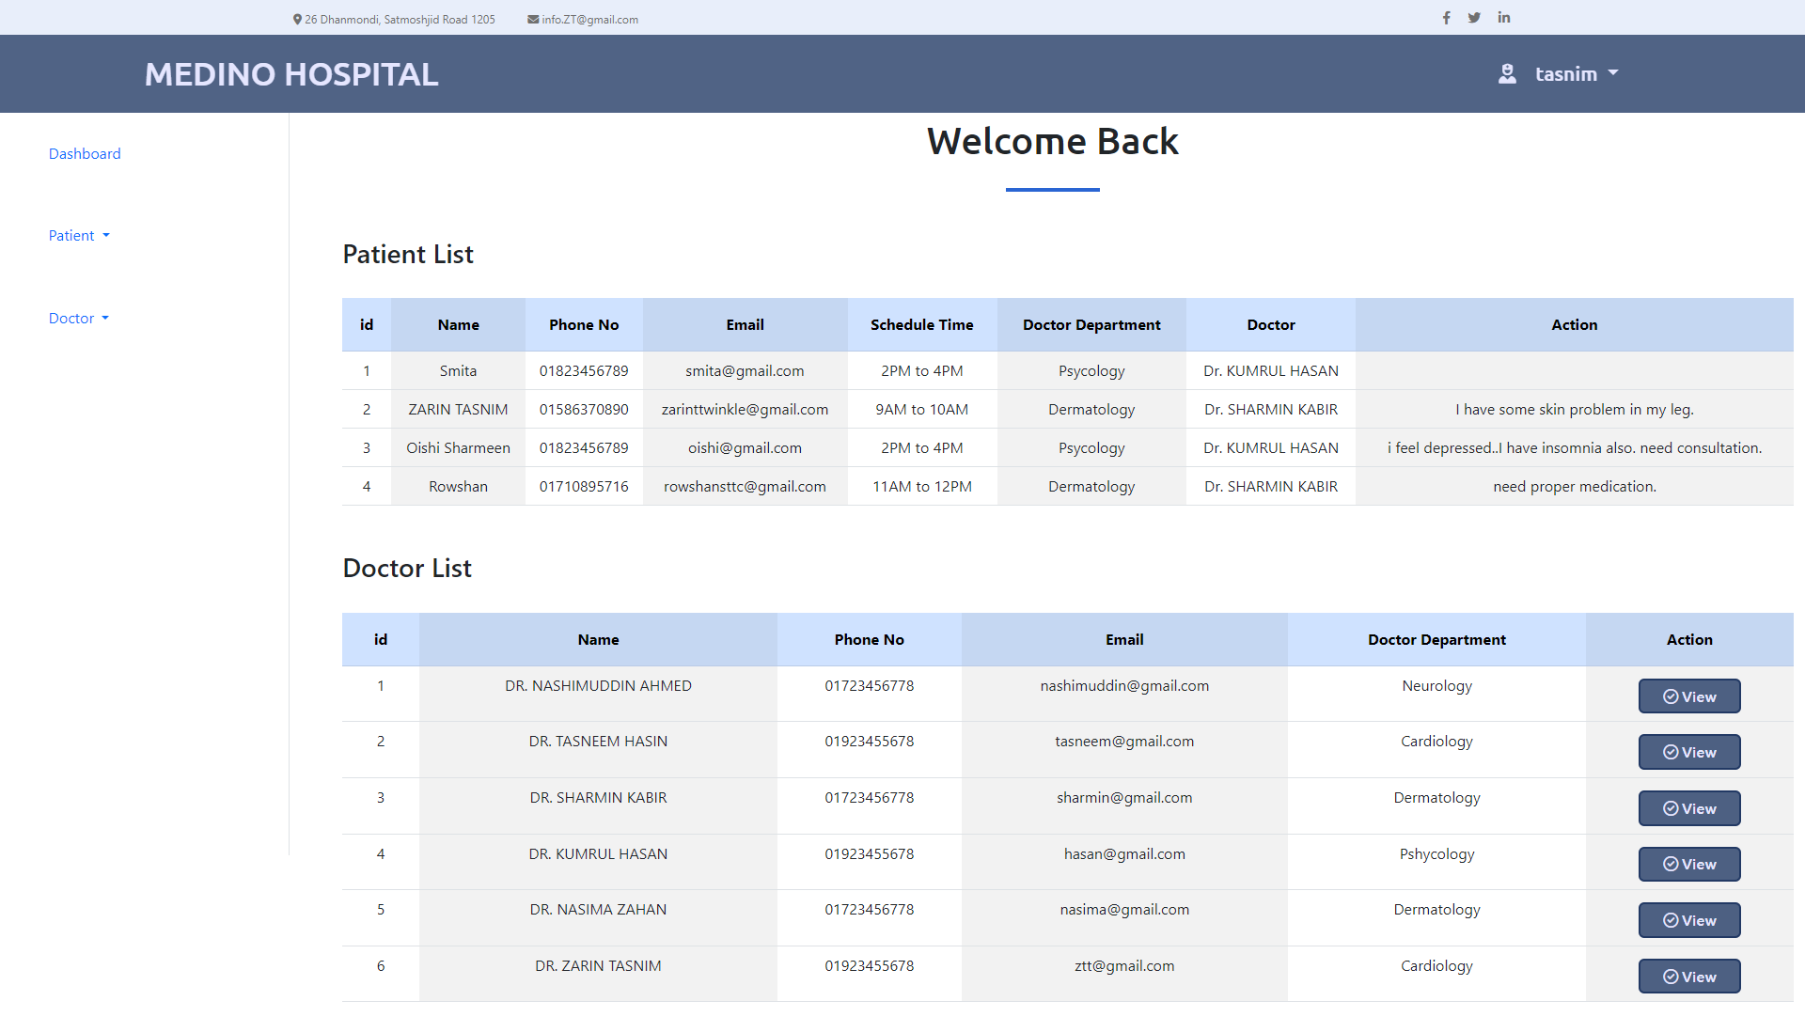
screenshots

Slide 22
conclusion
The Hospital Management System has been developed as it was intended to solve as requirement specification.
It is able to record and update database with more ease.
It has reached at a steady state by operating at a high level efficiency.
It can be altered in accordance with the future requirements of the organization.

